Slide 1
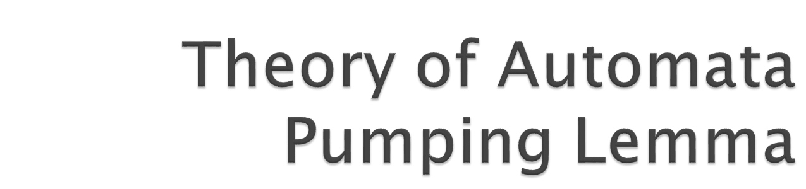

Slide 2
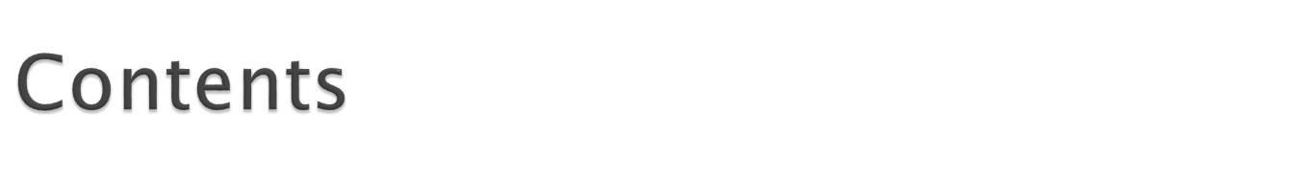
Definition of non-Regular Languages
Theorem 13
  Proof & Example
Theorem 14
  Proof & Example
Theory of Automata

Slide 3

By using FAs and regular expressions, we have been able to define many languages. Although these languages have many different structures, they take only a few basic forms:
    – Languages with required substrings
    – Languages that forbid some substrings
    – Languages that begin or end with certain substrings
    – Languages with certain even (or odd) properties, and so on.
We now turn our attention to some new forms, such as the language PALINDROME, or the language PRIME of all words a^{p}, where p is a prime number.
We shall see that neither of these is a regular language. We can describe them in English, but they can not be defined by an FA. We need to build more powerful machines to define them.
Theory of Automata

Slide 4

Definition:
A language that cannot be defined by a regular expression is called a non-regular language.
Notes:
    – By Kleene’s theorem, a non-regular language can also not be accepted by any FA or TG.
    – All languages are either regular or non-regular; none are both.
Theory of Automata

Slide 5
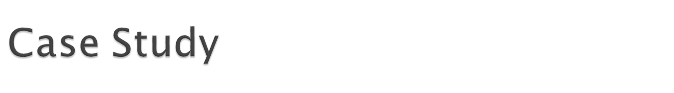
Consider the language
L = {Λ; ab; aabb; aaabbb; aaaabbbb; aaaaabbbbb; …}
The language L can also be written as
L = {a^{n}b^{n} for n = 0; 1; 2; 3; …}
or for short
L = {a^{n}b^{n}}
Note that although L is a subset of many regular languages, such as a*b*; the language defined by ab also includes such strings as aab and bb that are not in L.
Theory of Automata

Slide 6
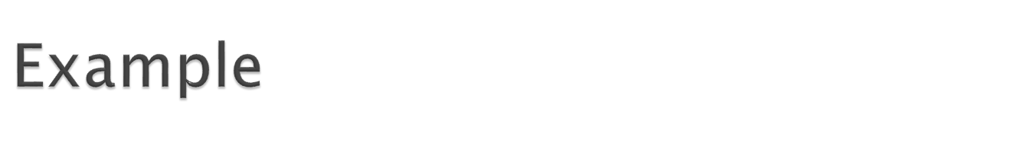
We shall show that the language L = {a^{n}b^{n}} is non-regular.
Suppose on the contrary that L were regular. Then there must exist some FA that accepts L.
Just for the sake of argument, let us assume that this FA has 95 states.
We know that this FA must accept the word a⁹⁶b⁹⁶.
The first 96 letter a’s of this input string trace a path through this machine.
The path cannot visit a new state when each input letter is read, because there are only 95 states. Therefore, at some point the path returns to a state that it has already visited.
In other words, the path must contain a circuit in it. (A circuit is a loop that can be made of several edges).
Theory of Automata

Slide 7
So, the path first wanders up to the circuit and then starts to loop around the circuit (maybe many times) until a b is read from the input.
At this point, the path can take a different turn following the b-edges, and eventually end up at a final state where the word a⁹⁶b⁹⁶ is accepted.
Just for the sake of argument again, let us say that the circuit that the a-edge path loops around has 7 states in it.
Then what would happen to the input string a⁹⁶⁺⁷b⁹⁶?
Just as in the case of the input string a⁹⁶b⁹⁶, the input string a⁹⁶⁺⁷b⁹⁶ would produce a path through the machine and loop around the circuit exactly in the same way, but one more time than the path produced by the input string a⁹⁶b⁹⁶.
Both paths, at exactly the same state in the circuit, begin to branch off on the b-road.
Theory of Automata

Slide 8
Once on the b-road, they both go the same 96 b-steps to arrive at the same final state.
But this would mean that the input string a¹⁰³b⁹⁶ is also accepted by this machine.
This is a contradiction since we assume that this FA accepts exactly the words in L = {a^{n}b^{n}}.
This contradiction means that the FA that accepts exactly the words in L does not exist. In other words, L is non-regular.
Theory of Automata

Slide 9
In summary, we can always choose a word in L that is large enough so that its path through the FA has to contain a circuit.
  Once we find that some path with a circuit can reach a final state, we ask ourselves what happens to a path that is just like the first one, but that loops around the circuit one extra time and then proceeds identically through the machine.
  The new path also leads to the same final state, but it is generated by a different input string which is not in the language L.
  We then can conclude that there is no FA that can accepts all the words in L and only the words in L. Therefore, L is non-regular.
This idea is called the pumping lemma discovered by Bar-Hillel, Perles, and Shamir in 1961. It is called “pumping” because we pump more letters into the middle of the words. It is called “lemma” because it is used as a tool to prove other results (i.e., certain specific languages are non-regular).
Theory of Automata

Slide 10
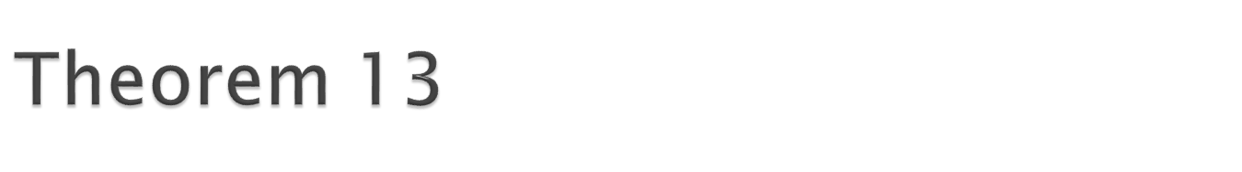
Let L be any regular language that has infinitely many words. Then there exist some three strings x, y, and z (where y is not the null string) such that all the strings of the form
xy^{n}z for n = 1, 2, 3, …
are words in L.
Theory of Automata

Slide 11
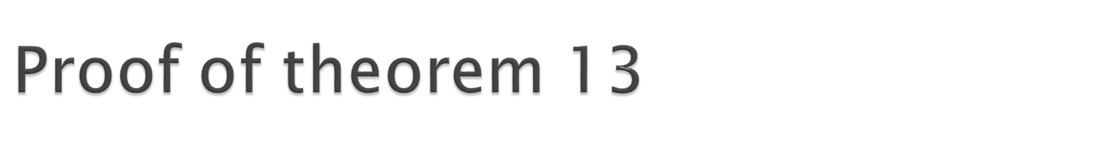
Since L is regular, there is an FA that accepts exactly the words in L.
Let w be some word in L that has more letters than there are states in FA.
When w generates a path through the machine, the path cannot visit a new state for each letter read, because there are more letters than states. Therefore, the path must at some point revisit a state that it has already visited. In other words, the path contains a circuit in it.
Theory of Automata

Slide 12
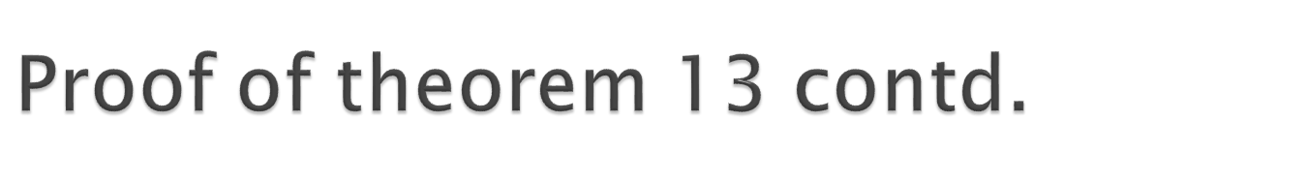
Let’s break the word w up into 3 parts:
  1. Part 1: Starting at the beginning, let x denote all the letters of w that lead up to the first state that is revisited. Note that x may be the null string if the path revisits the start state as its first revisit.
  2. Part 2: Starting at the letter after the substring x, let y denote the substring of w that travels around the circuit coming back to the same state the circuit began with. Because there must be a circuit, y cannot be the null string, and y contains the letters of w for exactly one loop around this circuit.
  3. Part 3: Let z be the rest of w, starting at the letter after y and going to the end of the string w. Note that z could be null, or the path for z could also loop around the y-circuit or any other. That means that what z does is arbitrary.
Clearly, from the definitions of these substrings, we have w = xyz. Recall that w is accepted by the FA.
Theory of Automata

Slide 13
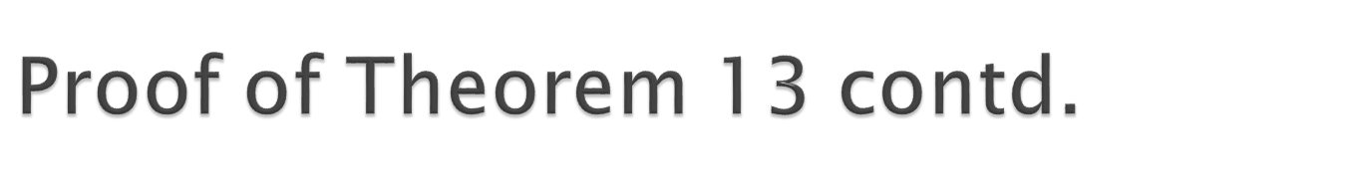
What is the path for the input string xyyz?
This path follows the path for w in the first part x and leads up to the beginning of the place where w looped around a circuit.
Then like w, it inputs the substring y, which causes the machine to loop back to this same state again.
Then, again like w, it inputs the substring y, which causes the machine to loop back to this same state another time.
Finally, just like w, it proceeds along the path dictated by the substring z and ends at the same final state that w did.
Hence, the string xyyz is accepted by this machine and therefore must be in the language L.
Theory of Automata

Slide 14
Similarly, the strings xyyyz, xyyyyz, ... must also be in L.
In other words, L must contain all strings of the form:
xy^{n}z for n = 1; 2; 3; …
Theory of Automata

Slide 15
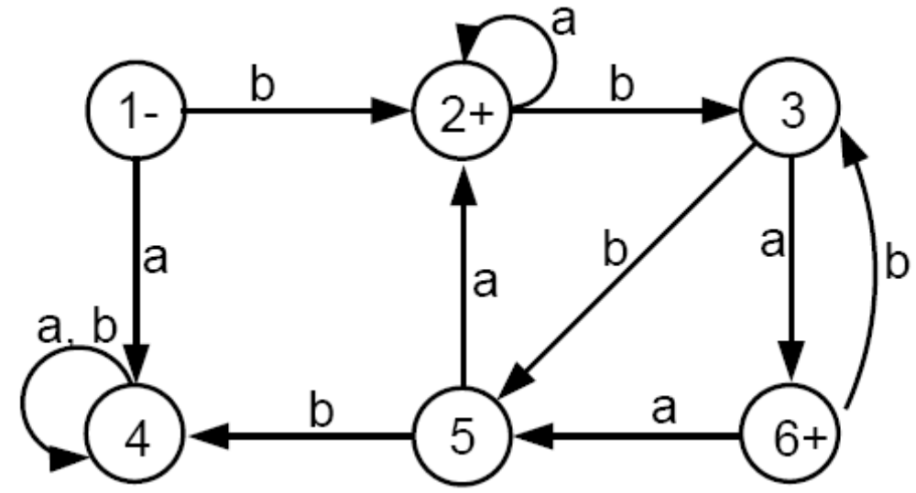
Consider the following FA that accepts an infinite language and has only six states:
Consider the word w = (b)(bba)(baba
1-2-3-5-2-3-6-3-6
Theory of Automata

Slide 16
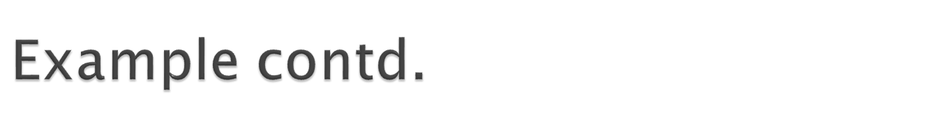
The x-part goes from the - state up to the first circuit: substring b
The y-part goes around the circuit consisting of states 2, 3, and 5: substring bba
The z-part is substring baba
What happens to the input string xyyz = (b)(bba)(bba)(baba)?
This string will loop twice around the circuit and is accepted.
The same thing happens with xyyyz, xyyyyz, and in general, for xy^{n}z.
Theory of Automata

Slide 17
Let us use Theorem 13 to show again that the language L = {a^{n}b^{n}} is not regular.
If L is regular then Theorem 13 says that there must be strings x, y, and z such that all words of the form xy^{n}z are in L.
A typical word of L looks like this: aaa…aaaabbbb…bbb. How to break it into x, y, and z?
If y contains entirely a’s, then when we pump it to xyyz, this string will have more a’s than b’s, which is not allowed in L.
Similarly, if y is composed of only b’s then xyyz will have more b’s than a’s, and is not allowed in L either.
Theory of Automata

Slide 18
If y have some a’s followed by some b’s then y must contain the substring ab.
  – So, xyyz must have 2 substrings ab’s.
  – But every word in L has exactly one substring ab.
  – Therefore, xyyz can not be a word in L.
The above arguments show that the pumping lemma cannot apply to L and therefore L is not regular.
Theory of Automata

Slide 19
Let EQUAL be the language of all words (over the alphabet ∑ = {a; b}) that have the same total number of a’s and b’s:
EQUAL = {Λ; ab; ba; aabb; abab; abba; baab; baba; bbaa; aaabbb; …}
Can you show that EQUAL is not regular?
Let L = {a^{n}ba^{n}} = {b; aba; aabaa; …}
Can you show that L is not regular?
Theory of Automata

Slide 20
EQUAL = {Λ; ab; ba; aabb; abab; abba; baab; baba; bbaa; aaabbb; …}
Assume EQUAL is regular language
String =xyz= (a)(bab)(ab)
Xyyyz= (a)(bab) (bab) (bab)(ab) doent belongs to the language equal
So contradiction to theorem 13
Its mean language is not regular
Theory of Automata

Slide 21
Let L = {a^{n}ba^{n}} = {b; aba; aabaa; …}
W= aaaaabaaaaa
X= aaa
Y=aab
Z=aaaaa
W= (aaa)(aab)(aaaaa)
Lets suppose y is pumped to length 2
xyyyz= (aaa)(aab)(aab)(aaaaa)
Theory of Automata

Slide 22
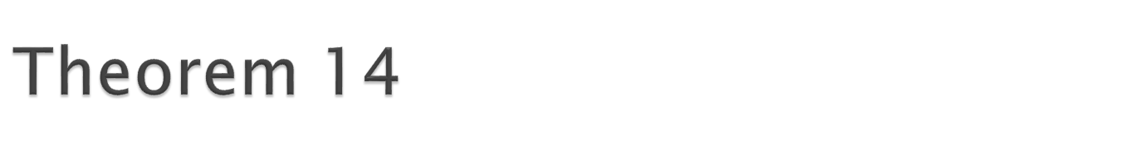
Let L be an infinite language accepted by a finite automaton with N states. Then, for all words w in L that have more than N letters, there are strings x, y, and z, where y is not null and length(x) + length(y) does not exceed N, such that w = xyz and all strings of the form xy^{n}z for n = 1; 2; 3; … are in L.
This is obviously just another version of Theorem 13 (the pumping lemma), for which we have already provided the proof.
The purpose of stressing the issue of lengths is illustrated in the following example.
Theory of Automata

Slide 23
We will show that the language PALINDROME is not regular.
We cannot use the first version of the pumping lemma (Theorem 13) because the strings
x = a; y = b; z = a
satisfy the lemma and do not contradict the language, since all the strings of the form xy^{n}z = ab^{n}a are words in PALINDROME.
So, we will use the second version of the pumping lemma (Theorem 14) to show that PALINDROME is non-regular.
Theory of Automata

Slide 24
Suppose for the contrary that PALINDROME were regular, then there would exist some FA that accepts it.
For the sake of argument, assume that this FA has 77 states.
Then, the palindrome w = a⁸⁰ba⁸⁰ must be accepted by this FA.
Because w has more letters than the FA has states, by Theorem 14 we can break w into three parts: x, y, and z.
Since length(x) + length(y) ≤ 77 (by Theorem 14), the strings x and y must both be made of all a’s, since the first 77 letters of w are all a’s.
Theory of Automata

Slide 25
Hence, when we form xyyz, we are adding more a’s to the front of w, but we are not adding more a’s to the back of w.
Thus, the string xyyz will be of the form
a^{(more than 80)}ba⁸⁰
and obviously is NOT a palindrome.
This is a contradiction, since Theorem 14 says that xyyz must be a palindrome. Hence, the language PALINDROME is NOT regular.
Theory of Automata

Slide 26
Consider the language
PRIME = {a^{p} where p is a prime}
Recall that a prime is a positive integer greater than 1 whose only positive divisors are 1 and itself, for example 2, 3, 5, 7 ...
Hence,
PRIME = {a^{p} where p is a prime}
= {aa; aaa; aaaaa; aaaaaaa; …}
Can you show that PRIME is non-regular?
Theory of Automata

